Slide 1
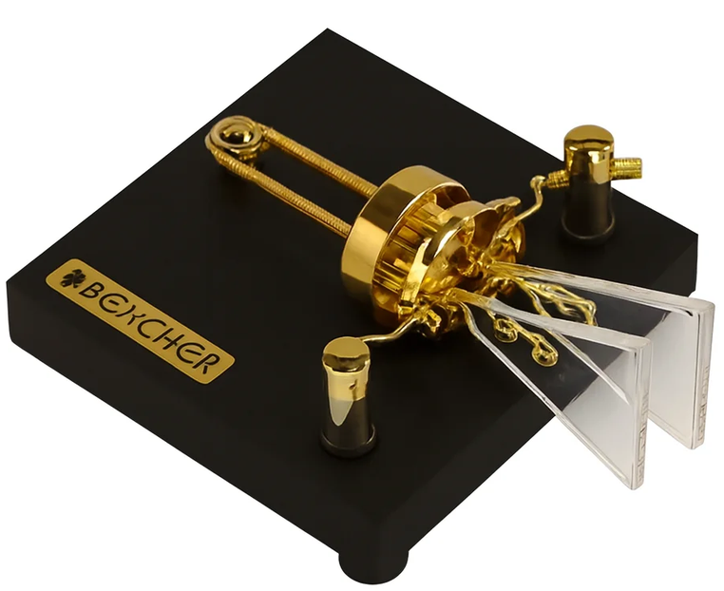
Get Started with CW the Easy Way!
Jim DeLoach, WUØI
8 September 2026
jim@deloach.net
This presentation can be found at:
www.deloach.net/SBCARA/
Bencher BY Series Iambic CW Paddle
v.1.0

Slide 2
Introduction

Slide 3
What is CW?
CW stands for “Continuous Wave”, a traditional radio communication mode in Amateur Radio that uses on-off keying of a single carrier frequency to transmit Morse code
It’s been around since the dawn of radio communications, and it’s still in use today

Slide 4
What’s So Special About CW?
CW gets through in weak signal conditions when voice communication will not work
  CW needs much less bandwidth – about 100 Hz – making it particularly useful in high noise (‘QRN’) or high interference (‘QRM’) situations
  Low power (‘QRP’) is much easier to use with CW
CW equipment is simpler, smaller, and cheaper
  You can even build CW equipment yourself!
But where CW really shines is for contests
  More on this later in this presentation

Slide 5
Morse Code

Slide 6
How to Decode Morse Code
Software and equipment can now decode CW Morse code for you:
  Apps like CW Decoder, MRP40, and Fldigi can decode CW, using your sound card and PC
  Some newer rigs include built-in CW decoding, like the Icom IC-7300MK2
  Stand-alone decoder boxes exist, like the DitStorm Cypher
But to use CW effectively, it really helps to be able to decode the CW yourself by ear – at least a little bit
  Without this, it is hard to be responsive enough to what is happening in the QSO
So how do you start learning Morse Code?

Slide 7
How To Learn Morse Code - Apps
LOTS of software apps are out there for you to get started learning Morse Code – I asked around and here are a few favorites:
Morse Mania: Android / iOS app for learning Morse Code from scratch using the “Koch Method”
  With the “Koch Method”, you learn characters at full speed right from the beginning, starting with 2 characters, then steadily adding characters as your proficiency grows
G4FON (SK) authored two popular PC programs including:
  a “Koch Method” trainer for beginners for the PC
  A contest trainer that simulates specific contests in realistic conditions
Morse Runner: also simulates realistic conditions for contests – what I use to get ready for Field Day
RufzXP: builds Morse copying speed by receiving call signs

Slide 8
How To Learn Morse Code –
Online Programs & Resources
There are also educational programs as well as online classes and other resources – here are a few favorites:
CW Academy: offers free, structured, small-group online instruction and peer mentoring
Long Island CW Club: has weekly online video conference classes
Learn CW Online (LCWO): offers an online, browser-based Koch Method CW course, with community score tracking and a community forum
  Tim has set up a LCWO User Group for the SBCARA

Slide 9
How to Get Started with CW Once You Know Some Morse

Slide 10
How to Get Started with CW
Once you have practiced Morse code with an app and/or with an online class, and you’re ready to dip your toe in the water, it’s time to get on the air!
The easiest way to start using CW is during friendly contests

Slide 11
Why Contests Are the Best Way to Start Using CW
The exchanges in many CW contests & other on-air events are short and highly prescribed/predictable, thus easier to copy
Also, certain contests and other events are just more friendly to CW newbies
  Non-DX contests, where sophisticated multipliers are not involved and participants are encouraged to maximize total number of QSOs, tend to be the best
  Think Field Day, Winter Field Day, California QSO Party, etc.
Best to avoid contests that involve a sequence number

Slide 12
Other Advantages of Contesting with CW
CW contest exchanges can be surprisingly quick
  Much quicker than the digital modes and even quicker than voice when well executed
Exchanges work reliably in much weaker signal conditions and when operating QRP
‘QRM’ interference and pile-ups are much easier to manage with CW, so you get through them quicker
Often CW QSOs are awarded more points

Slide 13
Example of a CW Field Day Exchange
W1AW, a 3A station in Connecticut, is calling CQ
N6SBC, a 5A station in Santa Clara Valley, is responding to CQs
W1AW is calling CQ. Note the lean & mean CQ – no ‘K’ at the end, no going on and on…
CQ FD W1AW W1AW FD
N6SBC responds with the call sign sent a single time
N6SBC
W1AW acknowledges N6SBC’s call sign and sends its FD class and section.
N6SBC 3A CT
N6SBC sends ‘R’, meaning W1AW’s exchange was ‘received’, then sends its FD class and section.
R 5A SCV
W1AW acknowledges receipt of N6SBC’s FD exchange by sending ‘TU’ = ‘Thank You’, and the QSO successfully completes.
TU QRZ W1AW FD
W1AW then immediately calls QRZ and is looking for the next station.
List of CW abbreviations.
Audio generated using morsecodes.io.

Slide 14
Field Day Exchange Variations
– Missed Call Sign
W1AW, a 3A station in Connecticut, is calling CQ
N6SBC, a 5A station in Santa Clara Valley, is responding to CQs
CQ FD W1AW W1AW FD
N6SBC
W1AW did not copy the full call sign and is asking the station starting with ‘N6’ to come again.
N6?
N6SBC repeats the call sign, and the exchange moves forward as before.
N6SBC
N6SBC 3A CT
R 5A SCV
TU QRZ W1AW FD
List of CW abbreviations.
Audio generated using morsecodes.io.

Slide 15
Field Day Exchange Variations
– Missed Section
W1AW, a 3A station in Connecticut, is calling CQ
N6SBC, a 5A station in Santa Clara Valley, is responding to CQs
CQ FD W1AW W1AW FD
N6SBC
N6SBC 3A CT
R 5A SCV
W1AW missed the ARRL Section and is asking for it to be repeated
SEC?
N6SBC repeats the ARRL Section.
SCV SCV
R TU QRZ W1AW FD
W1AW acknowledges receipt of N6SBC’s FD exchange and moves on.
List of CW abbreviations.
Audio generated using morsecodes.io.

Slide 16
Field Day Exchange Variations
– Chattier QSO Wrap-up
W1AW, a 3A station in Connecticut, is calling CQ
N6SBC, a 5A station in Santa Clara Valley, is responding to CQs
CQ FD W1AW W1AW FD
N6SBC
N6SBC 3A CT
Here, W1AW is wishing N6SBC ‘good luck’ and sending 73s. The ‘dit dit’ (two ‘e’ characters) is like waving goodbye.
R 5A SCV
RR GL 73 dit dit
Always respond to a ‘dit dit’ with a ‘dit dit’.
dit dit
CQ FD W1AW W1AW FD
W1AW then goes back to calling CQ..
List of CW abbreviations.
Audio generated using morsecodes.io.

Slide 17
Hints to Make Your First CW Contacts Easier
Respond to CQs (‘hunt & peck’) and don’t try to call CQ
Monitor the QSOs of the station you want to work before responding to the CQ
  Capture call sign and contest exchange
  Then, when you are ready to respond to the CQ, you know exactly what the station is going to send you

Slide 18
CW Speed to Use in Contests
For CQ callers going 20 words per minute (wpm) or faster, I have found that it is best to set my transmit speed to about 20wpm so that my call falls within the gap in time when the sender is listening
CQ callers will expect that you have already copied their call and exchange if you are struggling with CW, so they won’t typically slow down unless you ask them to (“PSE QRS” = “please slow down”)
If the CQ caller is going slower than 20 wpm, match that speed
  Listen for less proficient CW operators calling CQ at the high end of the band
It is always OK to ask for specific contest info again:
  “CALL?” asks for the call again
  “SEC?” asks for the section again
  “CLASS?” asks for the class again
  “AGN” just means “again” and the sender repeats the last transmission
List of CW abbreviations.

Slide 19
CW Equipment & Software Setup

Slide 20
Setting Up a CW Contest Station
It is really helpful to have the logging program (e.g., N3FJP) automatically send your outgoing Morse exchanges using F-keys
  That way, rarely will you need to manually send Morse with a straight key or paddle, and your hands stay on the keyboard
There are two common approaches:
  A command message sent from the logging program to the rig instructing it to send a specific Morse string
  An interface device like ‘WinKeyer’ that facilitates keying via the rig’s CW jack

Slide 21
Send CW Via Command Interface to the Rig
Icom IC-7300
Transceiver
Some rigs like the Icom IC-7300 allow you to transmit CW by embedding CW text in a command
This command string is then placed in a memory of the logging program tied to an F-key
Pressing the F-key will transmit the CW text
The CW paddle still works, and using it will abort any pending CW
CW speed is set in the rig, and is the same for text sent by the logging program or the paddle
This is the simplest & best approach
USB
KEY
Laptop
Type B
3-pin, ⅛”-M
USB
Type A
CW Paddle
Laptop running logging app like N3FJP
N3FJP CW string setup for the IC-7300:
In any N3FJP logging app, press CTRL-W to bring up the CW Setup Form.
Set ‘Keying Options’ to NONE.
Enter packets in the Fx fields with the CW to send enclosed within curly brackets like this:
RI:FEFE94E017{5A SCV}FD

Slide 22
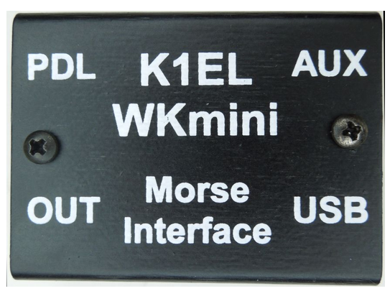
Send CW Via WinKeyer
For transceivers without a command capability, a “WinKeyer” interface box like the “WKmini” is used to translate serial characters into Morse
The CW strings are captured in the logging program
When an F-key is pressed, the CW string is sent over a serial interface to the WKmini, which keys the rig
CW speed for both the logging app and paddle is set in the WKmini
In my experience, ferrites must be used liberally to avoid RFI issues
Transceiver
CW Jack
Laptop
USB
WKmini
CW Paddle
Laptop running logging app like N3FJP
2.25" by 1.7" by .625"

Slide 23
CW Memories from 2026 Field Day
In the 50 CW QSOs I made at the 2026 N6SBC Field Day, I don’t remember once using the CW paddle
Every bit of CW I sent was from one of these N3FJP memories
The direct command interface to the trailer’s Icom IC-7300 was used, avoiding the need for a clunky WinKeyer interface
F-key | CW Text
F2 | N6SBC
F3 | R
F4 | 5A SCV
F5 | E E (dit dit)
F6 | <CALL> DE N6SBC
F7 | 73
F8 | 5A
F9 | SCV

Slide 24
Questions

Slide 25
Thank You! jim@deloach.net www.deloach.net/SBCARA/

